Slide 1
Muskingum County Head Start
Child Care Resources, Inc.
Annual Report
2018-2019
Our Mission: The basic purpose of Child Care Resources, Inc. is to improve the
quantity, quality, adequacy, and delivery of services to children and their families
who are at risk.

Slide 2

Table of Contents
3…… A Message to the Community
4…….Our Mission and Guiding Principles
5…….Our Program
6……. Program Accomplishments
7……. Agency-wide Parent Events
8……..Enrollment Benefits
9-11….Kindergarten Readiness & Early Head Start
12…… Annual Fiscal Report
13…….2018-2019 Operating Budget
14…….Parent Family Community Engagement Outcomes
15…….Board of Directors / Policy Council

Slide 3
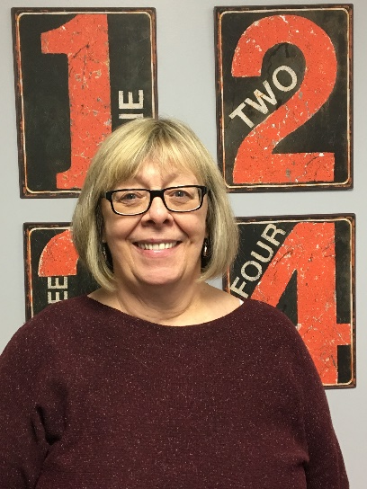
A Message to our Community
from our Executive Director, Jeri Johnson
I am pleased to present our 2018-2019 Child Care Resources, Inc., (CCR) Annual
Report. I would like to express my extreme gratitude to our dedicated staff who ensure
that we provide quality services to our families and children.
CCR provides services in Muskingum County to 210 Head Start children, 20 Early Head
Start (EHS), two (2) pregnant women, and 64 ECE children and their families.
We were able to extend hours for two (2) classrooms; Durban 1 and Durban 3 to 1020 hours
(full day).
The Carr Center Head Start site implemented an Intergenerational Program with the Adult Day Care
at Carr. It has been so exciting watching the interactions with the children and their grandfriends. Thank you
to Colleen Romito for coordinating this special program. We would not have been able to do it without her.
The good work we do in our communities would not be possible without the tireless commitment of our staff,
CCR Board of Directors, our parent Policy Council and community partners. Together we continue to ensure that
children are prepared to succeed in school and their parents are engaged every step of the way.
Please share in our successes by taking a few minutes to look at the fantastic work CCR Inc. Muskingum County
Head Start has accomplished during the past year. I look forward to another year of supporting Muskingum
County’s children, families, and communities.

Slide 4
Our Mission
The purpose of Child Care Resources, Inc. is to improve the quantity, quality, adequacy
and delivery of services to children and their families who are at risk.
Guiding Principles
Advocacy – We advocate on behalf of the children we serve by providing access to resources and protection of their rights and interests.
Empowerment – We provide the tools and environment to empower children and their families.
Learning – We are an organization dedicated to learning at all levels, especially for the early childhood years.
Partnerships – We deliver services through partnerships and collaboration.
Quality – We ensure the quality of our programs through continuous improvement and outcomes-based practices.
Respect – We respect diversity and acknowledge the value it brings to our community.
Wellness – We are committed to the emotional and physical well-being of our staff, children, and families.

Slide 5

Head Start – serving 210 children. Head Start is a comprehensive child development program which serves children from 3 years to compulsory school age in the Muskingum County area; it is child focused with an overall goal of increasing school readiness and social competence of young children in low-income families.
Early Head Start – serving 20 children 0-3 years old and 2 pregnant women. EHS is a comprehensive program to ensure needed services are provided to children, families and pregnant women.
Early Childhood Education (ECE) – serving 64 children. This program is an Ohio Department of Education funded public preschool serving children only 4 years to compulsory school age in the Zanesville City area. Children discover and explore their world through play and interactions through peers. We provide a full day of service by providing Head Start for 3 ½ hours and ECE for 3 ½ hours per day at Carr, Bonifield, Larzelere, and Durban 2.
OUR PROGRAM

Slide 6

All sites Adams Lane (ALPS), Blue Avenue, Carr, Durban
Drive, Larzelere Avenue, and the YMCA have received the Step up To Quality highest rating—a level 5.
Head Start Teachers provide 2 home visits and 2 Parent/Teacher conferences each year to help families prepare their children for Kindergarten. Family Advocates provide parent and family engagement, parent education and referral services to Head Start children and families.
Implemented an Intergenerational Program at Carr Head Start center in collaboration with the Carr Adult Daycare Program.
We received a duration grant which increased Durban 1 and Durban 3 to full day (1020 hours).
PROGRAM ACCOMPLISHMENTS

Slide 7
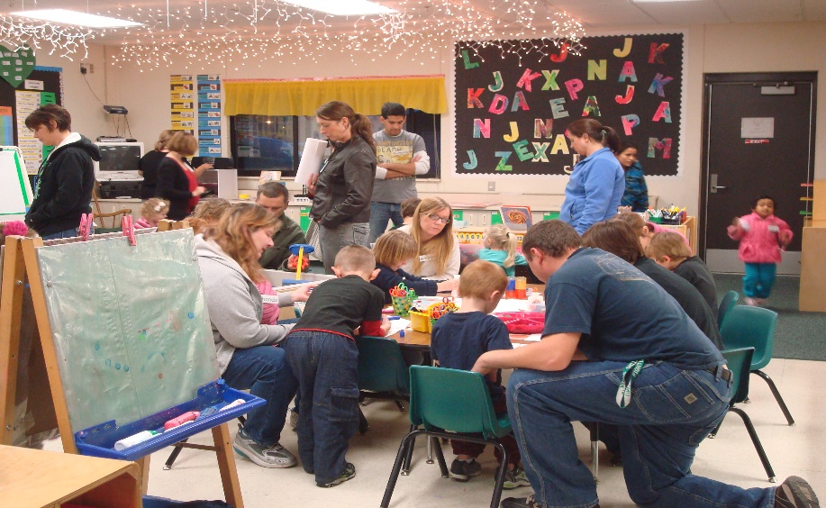
Art Exhibit Library Reception – October 24, 2019 at the John McIntire Library
Annual Feast – November 20-21, 2019 at Coburn United Methodist Church
Dr. Seuss Birthday Celebration - March 5, 2020 at Grace United Methodist Church
Family In Days at all the classrooms throughout the school year
AGENCY WIDE PARENT EVENTS

Slide 8

ENROLLMENT BENEFITS
Head Start served 201 families with 240 children
Early Head Start served 18 families & 2 pregnant women
HS Average Monthly Enrollment: 210 Children 100%
572
HS/EHS Home Visits made by Family Service staff
HS enrolled children 100% received
Medical Exams
98% received
Dental Exams
EHS enrolled children
91% received
Medical Exams
82% received
Dental Exams
EHS
Enrollment: 22
Participants 100%

Slide 9

How we prepare our children for Kindergarten:
Engage parents as partners in child’s education.
Design activities that support the Early Learning Development Standards / Head Start Early Learning Outcomes Framework.
Individualize according to student needs.
Collaborate with elementary schools, particularly Zanesville City Schools, to provide continuation of service and develop school readiness.
Monitor school readiness goals three (3) times a year. School Readiness Goals are shared with Zanesville City Schools annually to help prepare students of Kindergarten age.
KINDERGARTEN READINESS

Slide 10
School Readiness Goals
(At A Glance)
Scores below indicate children are meeting or exceeding expectations for their age.
Beginning Fall Score Ending Spring Score Growth
Social - Emotional 63% 79% 16%
Physical 66% 87% 21%
Mathematics 45% 72% 27%
Language 63% 85% 22%
Literacy 48% 76% 28%
Cognition 58% 82% 24%
KINDERGARTEN READINESS

Slide 11
Outcomes
(At A Glance)
Scores below indicate children are meeting or exceeding expectations for their age.
Fall Score Spring Score Growth
Social – Emotional 67% 72% 5%
*Physical 100% 83% -17%
*Mathematics 83% 79% -4%
*Language 88% 75% -13%
*Literacy 80% 77% -3%
Cognition 87% 89% 2%
*Outcomes didn’t increase due to starting program in October and high turnover with Home Base program.
EARLY HEAD START

Slide 12

ANNUAL FISCAL REPORT
Public Funding:
Office of Head Start……. .$2,425,581
Ohio Dept. of Education ...$256,000
USDA Food Program…….$118,958
Private Funding/Donations…...$0
In-Kind Donations……………..$574,342
TOTAL…………………………..$3,374,881

Slide 13
Personnel…………………….. $1,510,340
Fringe Benefits………………. $450,592
Supplies……………………… $119,325
Children’s Food/Supplies……. $126,901
Contractual…………………. $96,625
Transportation………………. $36,136
Facilities/Utilities…………… $142,125
Other………………………… $289,485
Equipment…………………... $16,607
$2,788,136
In-Kind……………………... $574,342
Total………………………… $3,362,478
2018/2019 OPERATING BUDGET
Laura J. MacDonald, CPA completed the A-133 Single Audit for the period of August 1, 2017 to July 31, 2018. The audit has been reviewed by the CCRI Board of Directors and submitted to all of the appropriate funding agencies. The CCRI Financial statements were found to be presented fairly and in conformity with accounting principles generally accepted in the United States of America.
The audit findings showed:
-no material weaknesses
-no significant deficiency
-no non-compliance and
-no questioned cost
The audit is available for review at the CCRI Administrative Office
1580 Adams Lane, Zanesville, Ohio

Slide 15
Board of Directors
Policy Council
Jeanie Blake…………….President
Mary Arnold…………….Vice-Chairperson
Claire Gately……………Secretary
Amy Tracey…………....Treasurer
Mary Arnold……………Community Representative
Jeanie Blake.…………..Community Representative
Kelly Coffey……………Community Representative
Candy Emmert…………Community Representative
Jason Glass………………Policy Council Representative
Colleen Romito…………Community Representative
Amy Wilson……………. Community Representative
Katie Brown…………….. Community Representative
The policy council representative works in a partnership
with key management staff and the board if directors to make
decisions about the design and operation of the Head Start
program.
The council also serves as a link to the parent committee, grantee,
public/private organizations and the community.
Tabby Schneider
Kerry Smith
Kimberly Gibson
Amy Newlon
Holly Wison
Chelsey Spencer
Jasmynn Tabler
Lila Fansler

