Slide 1
Muskingum County Head Start
Child Care Resources, Inc.
Annual Report
2023-2024
Our Mission: The basic purpose of Child Care Resources, Inc. is to improve the
quantity, quality, adequacy, and delivery of services to children and their families
who are at risk.

Slide 2

Table of Contents
3…… A Message to the Community
4…….Our Mission and Guiding Principles
5…….Our Program
6……. Program Accomplishments
7……. Agency-wide Parent Events
8……..Enrollment Benefits
9-11….Kindergarten Readiness & Early Head Start
12…… Annual Fiscal Report
13…….2023-2024 Operating Budget
14…….Parent Family Community Engagement Outcomes
15…….Board of Directors / Policy Council

Slide 3
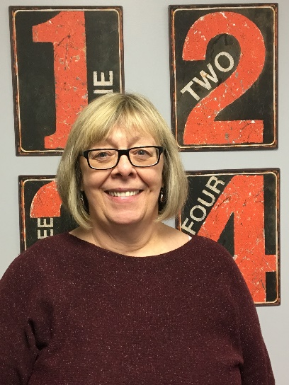
A Message to our Community
from our Executive Director, Jeri Johnson
I am pleased to present our 2023-2024 Child Care Resources, Inc., (CCR) Annual
Report. I would like to express my extreme gratitude to our dedicated staff who ensure
that we provide quality services to our families and children.
CCR provides services in Muskingum County to 137 Head Start children, 49 Early Head
Start (EHS), three (3) pregnant women, and 18 ECE children and their families.
The good work we do in our communities would not be possible without the tireless commitment of our staff,
CCR Board of Directors, our parent Policy Council and community partners. Together we continue to ensure that
children are prepared to succeed in school and their parents are engaged every step of the way.
Please share in our successes by taking a few minutes to look at the fantastic work CCR Inc. Muskingum County
Head Start has accomplished during the past year. I look forward to another year of supporting Muskingum
County’s children, families, and communities.

Slide 4
Our Mission
The purpose of Child Care Resources, Inc. is to improve the quantity, quality, adequacy
and delivery of services to children and their families who are at risk.
Guiding Principles
Advocacy – We advocate on behalf of the children and families we serve by providing access to resources and protection of their rights and interests.
Empowerment – We provide the tools and environment to empower children and their families.
Learning – We are an organization dedicated to learning at all levels, especially for the early childhood years.
Partnerships – We deliver services through partnerships and collaboration.
Quality – We ensure the quality of our programs through continuous improvement and outcomes-based practices.
Respect – We respect diversity and acknowledge the value it brings to our community.
Wellness – We are committed to the emotional and physical well-being of our staff, children, and families.

Slide 5
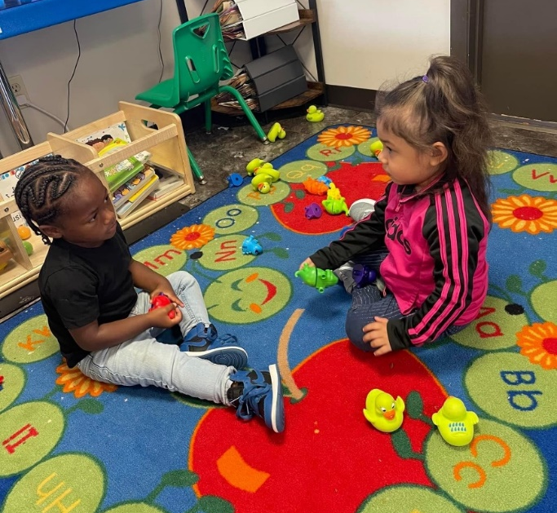
Head Start – serving 137 children. Head Start is a comprehensive child development program which serves children from 3 years to compulsory school age in the Muskingum County area; it is child focused with an overall goal of increasing school readiness and social competence of young children in low-income families.
Early Head Start – serving 49 children 0-3 years old and 3 pregnant woman. EHS is a comprehensive program to ensure needed services are provided to children, families and pregnant women.
Early Childhood Education (ECE) – serving 18 children. This program is an Ohio Department of Education funded public preschool serving children only 4 years to compulsory school age in the Zanesville City area. Children discover and explore their world through play and interactions through peers. We provide a full day of service by providing Head Start for 3 ½ hours and ECE for 3 ½ hours per day at Larzelere.
OUR PROGRAM

Slide 6

PROGRAM ACCOMPLISHMENTS 23/24
Began the program year with full class sizes and normal days. Family style meals, All family events in person.
Parent Educator (Homebase) obtained her Car Seat Certification & She was appointed to the Doula Advisory Board.
Mental Health services were also provided to families & staff.
All sites received/maintained five stars from SUTQ, which is the highest accomplishment anyone can receive. This means that all our sites goes above and beyond what is required to provide high quality education to our children and families.

Slide 7
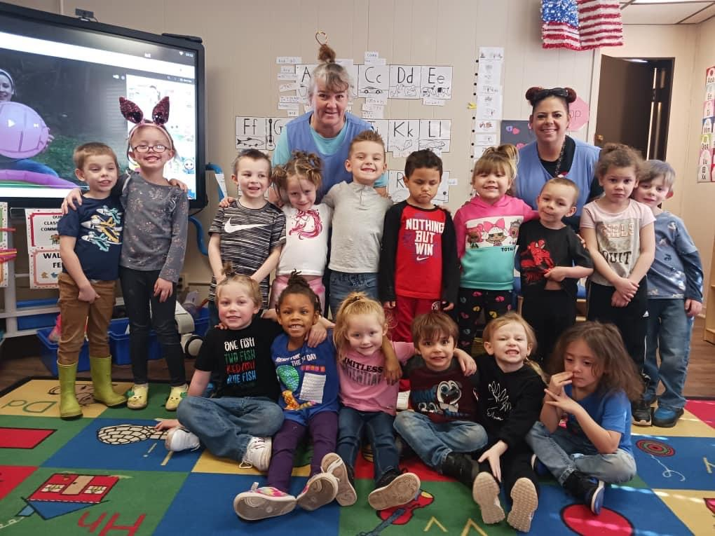
Art Exhibit Library Reception – October 2023 Artwork & books displayed @ Muskingum County Library. All Head Start and Early Head Start families invited to an evening of fun!
Annual Feast held at Colburn Church – November 2023
All Early Head Start and Head Start families invited to an evening of family fun, food and community awareness.
Dr. Seuss Birthday Celebration – March 2024
An evening of celebration and family fun with a focus of achieving school readiness goals and promoting literacy.
Graduation – May 2024
In person graduation. Held at North Terrace Church.
AGENCY WIDE PARENT EVENTS

Slide 8

ENROLLMENT BENEFITS 2023/2024
Head Start served 137 families with 137 children
Early Head Start served 45 families with 49 children & 3 pregnant women
Average Monthly Enrollment: HS Children 85%
*EHS Children 82%
HS/EHS Home Visits made by Family Service staff an average of 3 per family
HS enrolled children 100% received
Medical Exams
85% received
Dental Exams
EHS enrolled children
100% received
Medical Exams
*70% received
Dental Exams

Slide 9

We prepare our children for Kindergarten by…
Engaging parents as partners as partners in their children’s education.
Designing activities to support the Early Learning Development Standards and Head Start Early Learning Outcomes Framework.
Individualizing lessons according to student needs.
Collaborating with elementary schools, particularly Zanesville City Schools, to provide continuation of service and develop school readiness.
Monitoring school readiness goals three times a year. School readiness goals are shared with Zanesville City Schools annually to help prepare students of Kindergarten age.
Implementing Creative Curriculum, which is a research-based curriculum that features hands-on, project-based investigations as a pathway to learning.
KINDERGARTEN READINESS

Slide 10
KINDERGARTEN READINESS
School Readiness Goals
(At A Glance)
Scores below indicate children are meeting or exceeding expectations for their age.
Beginning Fall Score: Winter Score: Spring Score: Growth:
Social-Emotional 55% 85% 90% 5%
Physical 59% 87% 91% 4%
Mathematics 41% 59% 76% 17%
Language 45% 76% 92% 16%
Literacy 52% 70% 83% 13%
Cognition 54% 80% 89% 9%

Slide 11
EARLY HEAD START
Outcomes (At A Glance)
Scores below indicate children are meeting or exceeding expectations for their age.
Beginning Fall Score: Winter Score: Spring Score: Growth:
Social-Emotional 81% 80% 89% 9%
Physical 85% 85% 89% 4%
Mathematics 79% 79% 83% 4%
Language & Literacy 81% 85% 91% 6%
Self Regulation 71% 79% 83% 4%

Slide 12

ANNUAL FISCAL REPORT
Public Funding:
Office of Head Start……. . $2,877,584
Ohio Dept. of Education... $76,500
USDA Food Program……. $138,828
Private Funding/Donations…...$0
In-Kind Donations…………….$381,354
TOTAL………………………….. $3,474,266

Slide 13

Personnel……………………… $1,876,363
Fringe Benefits………………. $622,014
Supplies………………………… $64,306
Children’s Food/Supplies.. $138,828
Contractual……………………. $38,847
Transportation……………….. $37,614
Facilities/Utilities……………. $103,122
Other……………………………… $158,344
$3,069,580
Supplement $23,332
In-Kind…………………….......... $381,354
Total……………………………….. $3,474,266
2023/2024 OPERATING BUDGET

Slide 14
Annual Audit Results
INDEPENDENT AUDITOR’S REPORT By Snodgrass
Qualified Opinion
We have audited the accompanying financial statements of Child Care Resources, Inc. (a nonprofit organization), which comprise the statement of financial position as of July 31, 2024, the related statements of activities and cash flows for the fiscal year then ended, and the related notes to the financial statements.
In our opinion, except for the effects of Child Care Resources, Inc. not reporting its expenses by their functional expense classification, as described in the Basis for Qualified Opinion section of our report, the financial statements referred to in the first paragraph present fairly, in all material respects, the financial position of Child Care Resources, Inc. as of July 31, 2024, and the changes in its net assets and its cash flows for the fiscal year then ended in accordance with accounting principles generally accepted in the United States of America.

Slide 15
Board of Directors
Policy Council
Mary Arnold…………….Chairperson
Amy Wilson…………….Vice-Chairperson
Abby Corder……………Secretary
Jeanie Blake…………....Treasurer
Abby Trout…………Community Representative
Kimberly Gibson………………Policy Council Representative
Michele Hoskinson…………Community Representative
Ashlie Spiker……………. Community Representative
The policy council representative works in a partnership
with key management staff and the board if directors to make
decisions about the design and operation of the Head Start
program.
The council also serves as a link to the parent committee, grantee,
public/private organizations and the community.
Jonathon Tanner - Chairperson
Kimberly Gibson – Board Rep.
Mercedes Elson- Secretary
Corey Finck
Jennifer Anderson
Kaitlynn Sheene
Brittany Dusenberry
Caye Walker
Paige Coss

